Slide 1
Meeting 09/03: Hot and Cold
Joren Janzing

Slide 2
Content
What are the events?
Composites: movie time!

Slide 3
Hot and cold events: How to define them?
Take 24 month rolling mean, detrend with 25 year rolling mean.
Physical threshold: - how to make this less arbitrary?
Composites are now aligned by first month of detection. What is the best physical way to do it? By their peak?

Slide 4
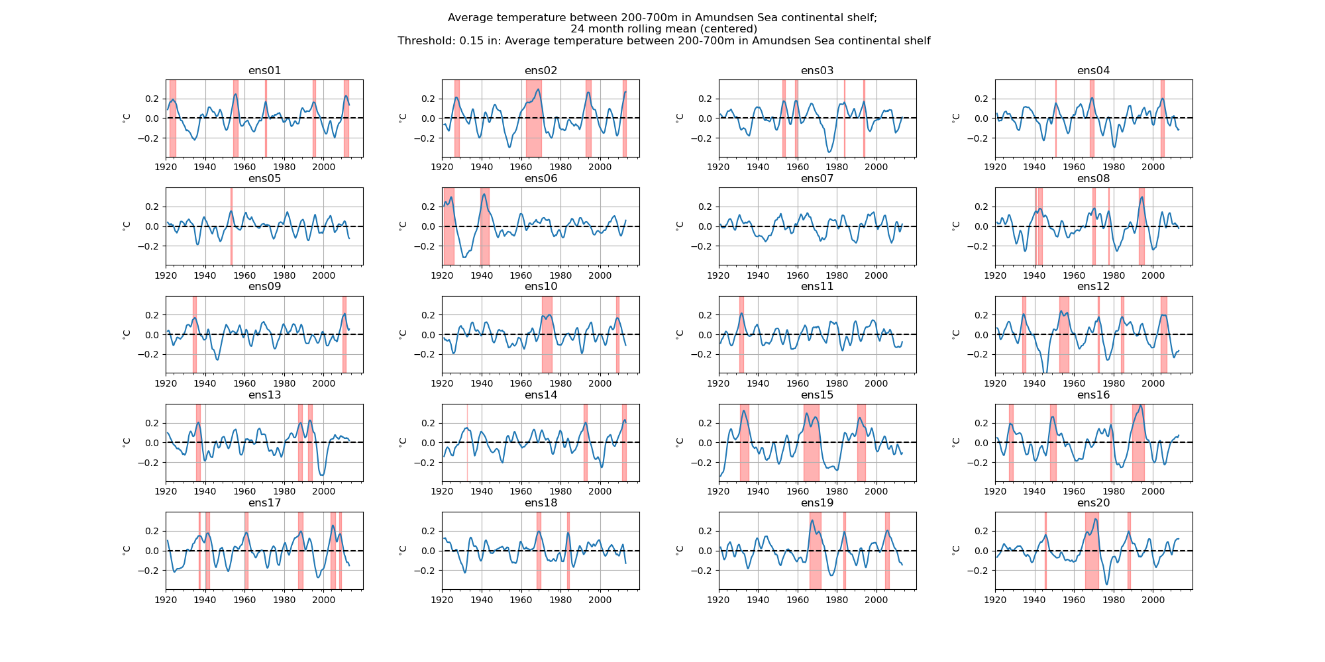

Slide 5
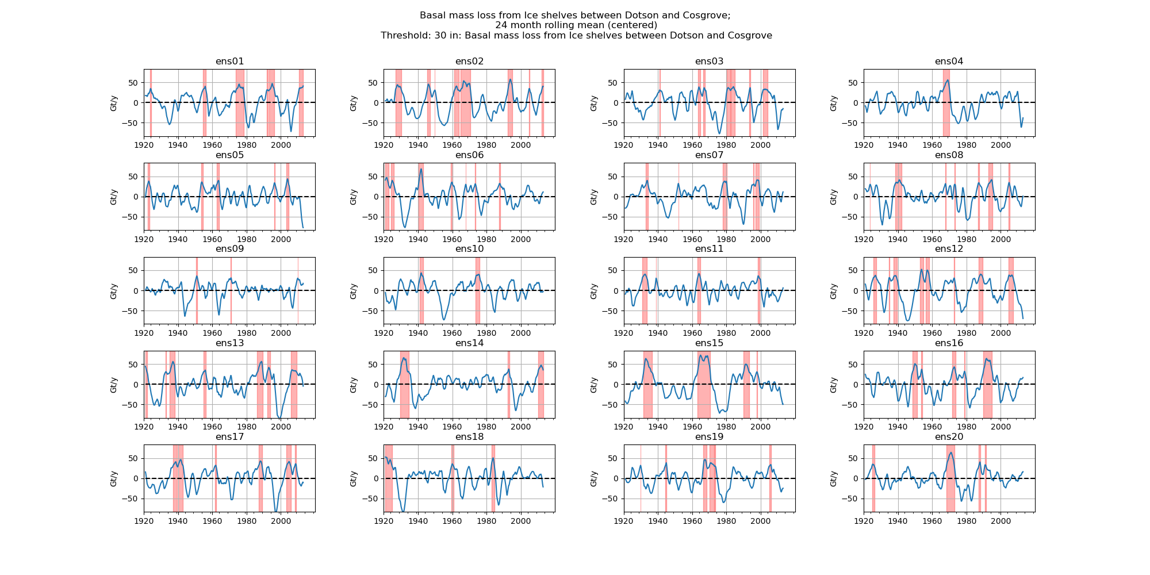

Slide 6
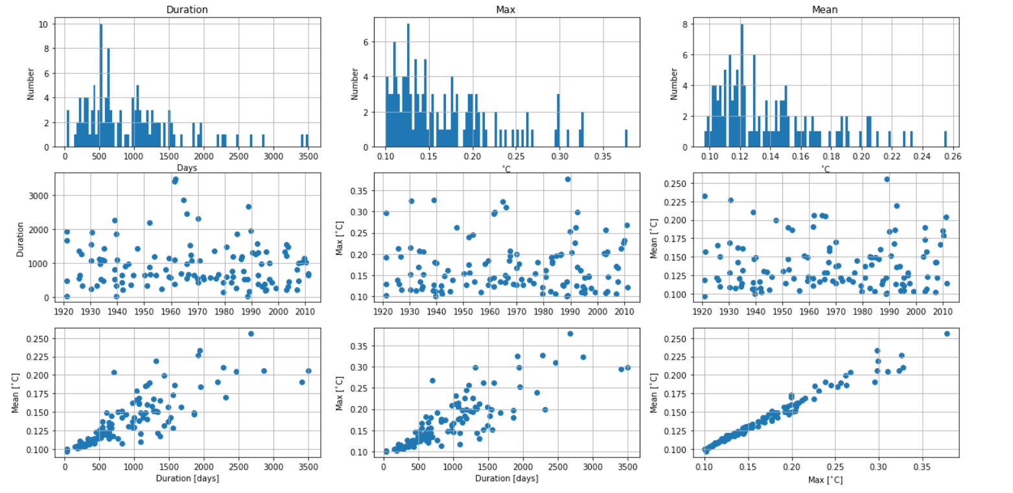

Slide 7
Sensitivity to threshold? Define based on melt?

Slide 8
What do they look like?
Composites!

Slide 9
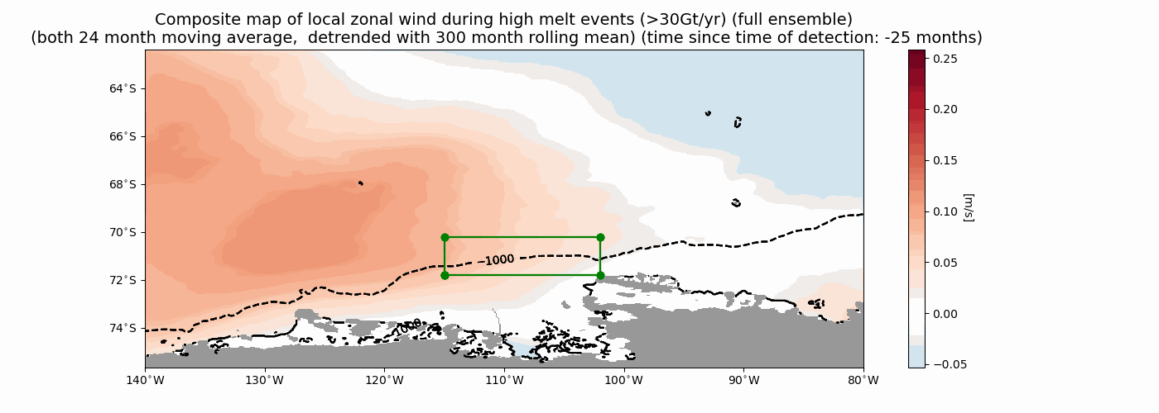
Wind High Melt

Slide 10
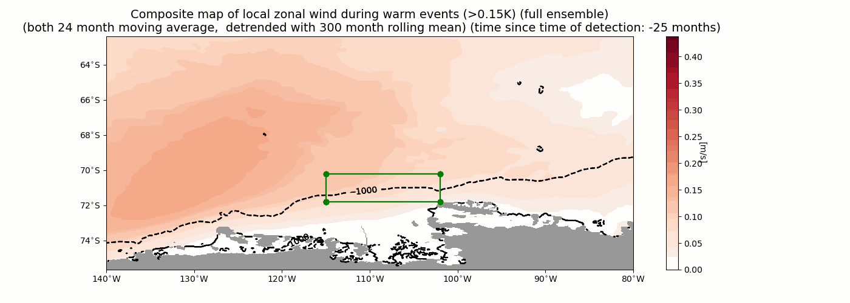
Wind Warm

Slide 11
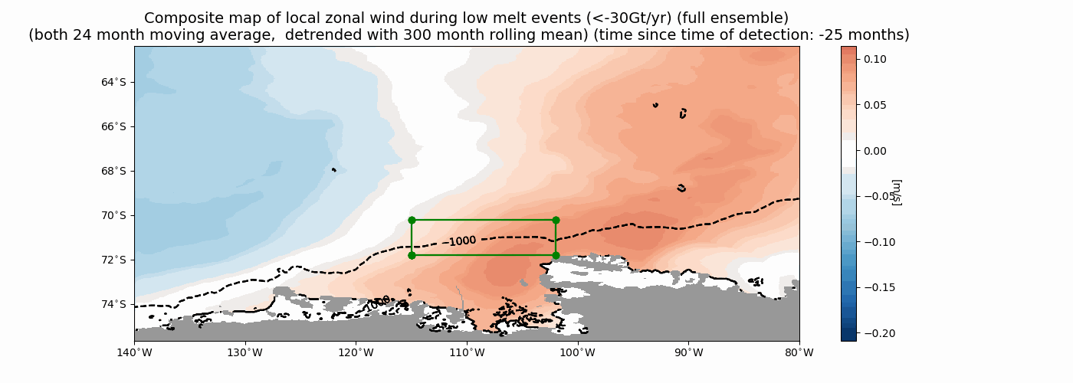
Wind Low Melt

Slide 12
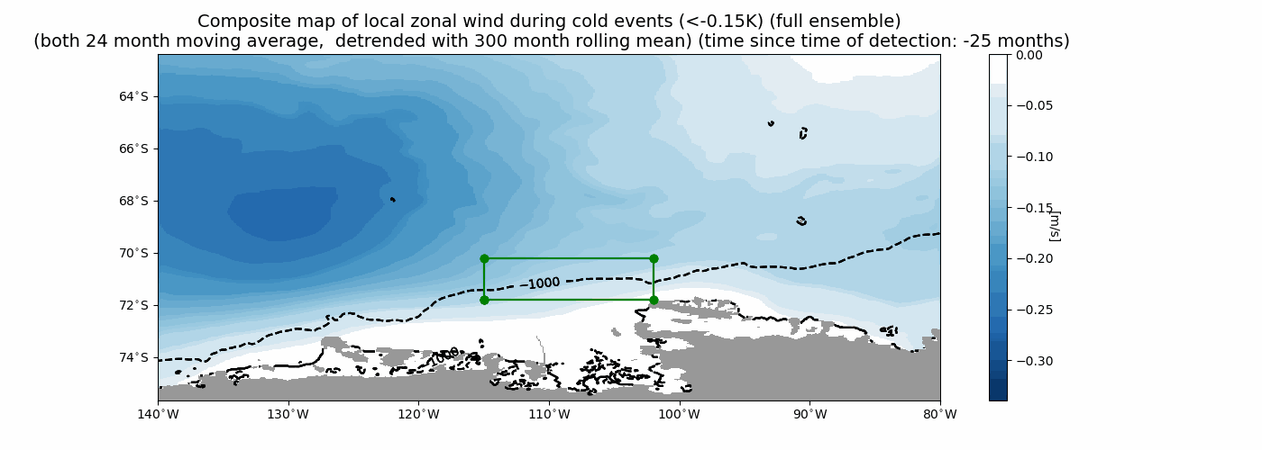
Wind Cold

Slide 13
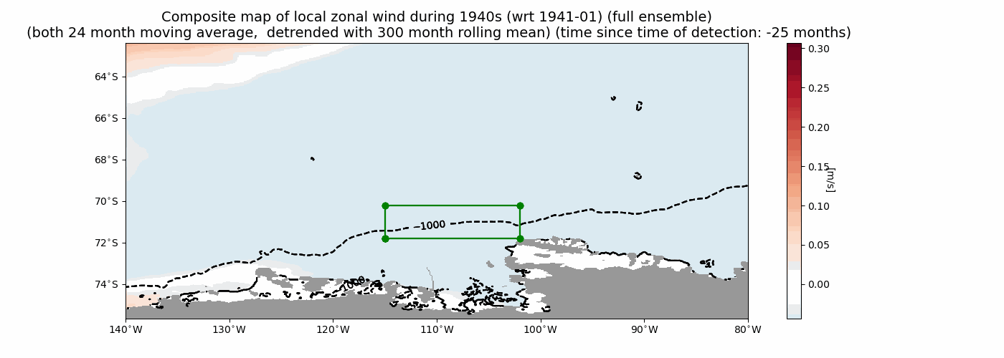
1940s!!

Slide 14
Winds during events:
Melt events: anomaly moves from west to east, focusses on the shelfbreak!
Temperature events: anomaly further off coast.

Slide 15
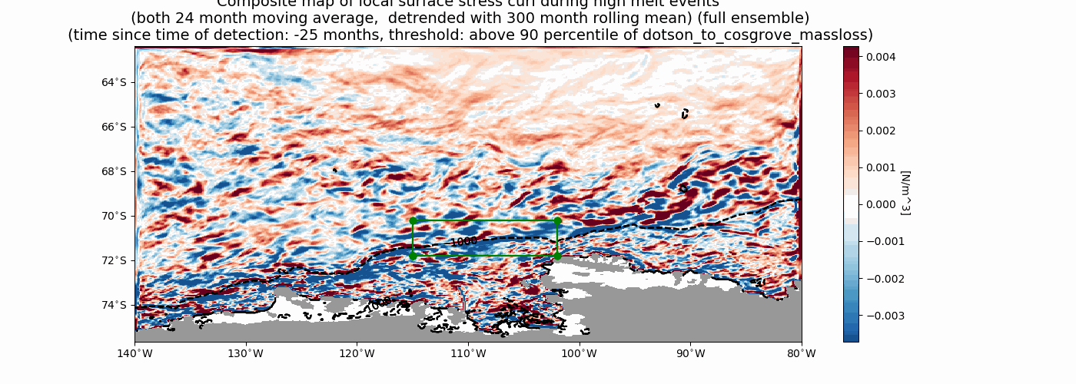
Curl High/Low

Slide 16
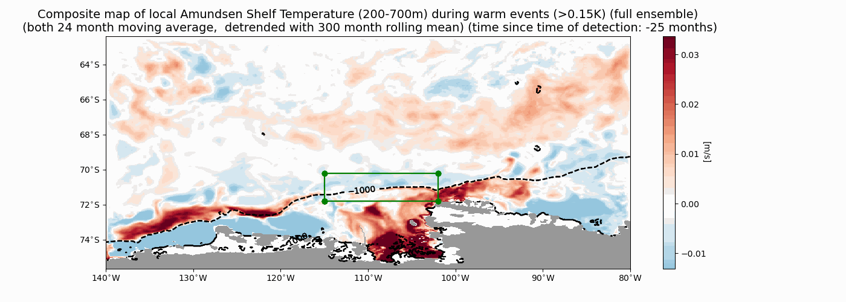
Temperature Warm

Slide 17
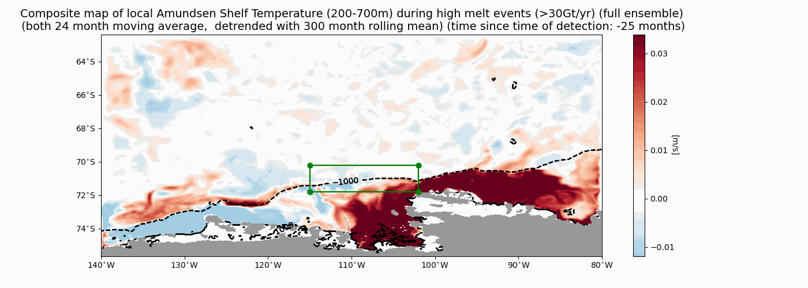
Temperature High melt

Slide 18
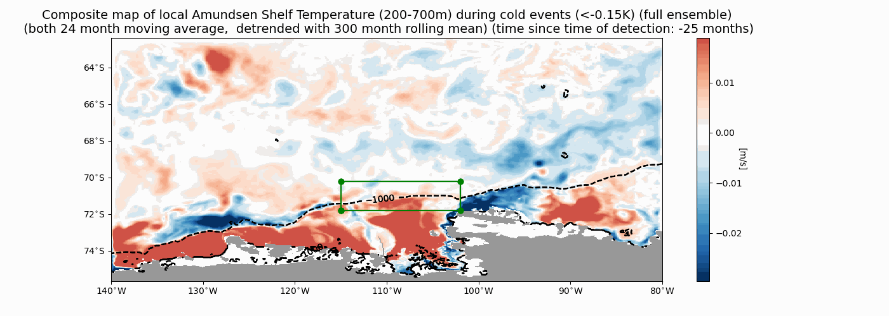
Temperature Cold

Slide 19
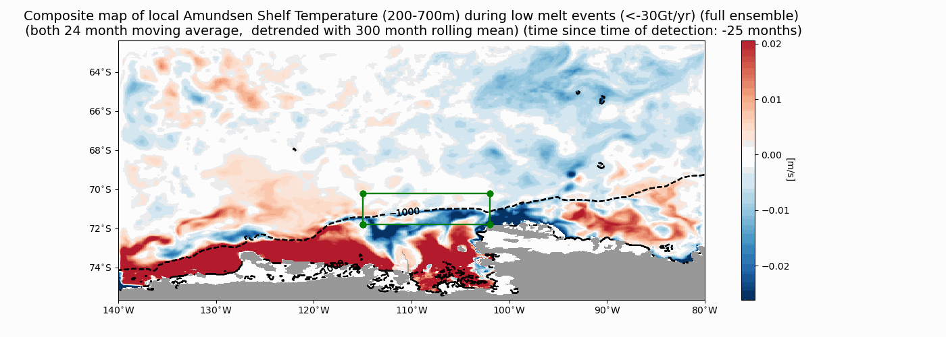
Temperature Low Melt

Slide 20
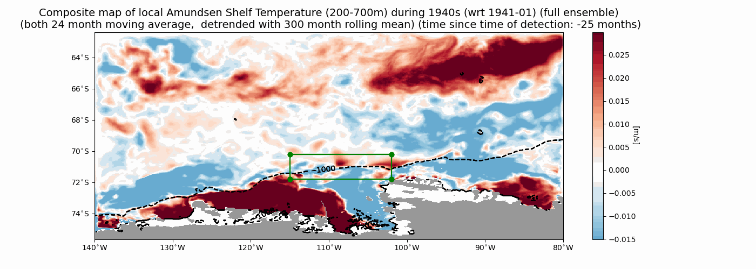
1940

Slide 21
Temperature
Why is there already warm water present?

Slide 22
Next steps
Cross sections.
Velocity?
5 year running mean check?
Anomaly of 1940 wrt to mean?

